Slide 1
SPINNAKER ANALYTICS
Presented by LAKSHAY SINGH RAJPUT

Slide 2
agenda
Introducing PROJECT AIMS
Data Exploration
Preprocessing , Outlier Handling
Effective delivery techniques
Q&A

Slide 3

introduction
CLUSTERING SOLAR ENERGY PRODUCTION ZONES
THIS PROJECT AIMS TO LEVERAGE DATA CONTAINING INFORMATION ON EXISTING SOLAR POWER PROJECTS WITHIN THE TARGET AREA. THROUGH THE ANALYSIS OF THIS DATA, OUR GOAL IS TO GROUP (CLUSTER) GEOGRAPHICAL AREAS BASED ON THEIR OVERALL ENERGY PRODUCTION.

Slide 4
Data Exploration
DATA SHAPE: (218115, 17)
NO DUPLICATED ROWS
NO EMPTY ROWS
ALL DATA TYPES ARE CORRECT
COLUMNS WITH NULL VALUES: CITY/TOWN, ZIP, DIVISION, SUBSTATION, CIRCUIT ID, DEVELOPER, METERING METHOD, ENERGY STORAGE SYSTEM SIZE (KWAC)
DATASET HAS EXTREME OUTLIERS PRESENT IN MULTIPLE COLUMNS, ESPECIALLY BEYOND THE 75TH PERCENTILE

Slide 5
Preprocessing Activities Performed
COLUMNS WITH MORE THAN 40% NULL VALUES WERE DROPPED.
ENERGY STORAGE SYSTEM SIZE (KWAC)' WAS DROPPED DUE TO 98% NULL VALUES.
CATEGORICAL COLUMNS WITH LESS THAN 40% NULL VALUES WERE IMPUTED USING MODE.
'DATA THROUGH DATE' HAS ONLY ONE UNIQUE VALUE — DROPPED.
'PROJECT ID' HAS ONLY UNIQUE VALUES — DROPPED

Slide 6
Outlier Handling
OUTLIERS WERE NOT REMOVED BECAUSE EXTREMELY HIGH ENERGY VALUES MAY REPRESENT LARGE-SCALE SOLAR PROJECTS CRUCIAL FOR STRATEGIC ANALYSIS AND TRUE ENERGY POTENTIAL
Column | 75th Percentile | Max Value | Outlier Gap
Estimated PV System Size (kWdc) | 10.24 | 43,470 | Extreme jump
PV System Size (kWac) | 8.75 | 31,500 | Extreme jump
Estimated Annual PV Energy Production (kWh) | 12,017 | 51,026,820 | Massive outlier

Slide 7
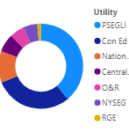
EDA
PSEGLI appears most frequently in the data.
This indicates that PSEGLI plays the largest role in solar electricity distribution.
Con Ed, National Grid, and Central Hudson also show a significant presence.
NYSEG and RGE appear less frequently, possibly due to limited coverage or lower adoption.
PSEGLI is used most often, showing highest utility involvement in solar projects.this may be due to better service, wider coverage, or lower costs.

Slide 8
Categorized columns (City/Town, Zip, Division, Substation, Circuit ID, Developer, Method) into High, Mid, Low, Very Low based on similar properties.
Simplified model observation and reduced complexity through categorization.
Retained top 20 County categories, grouped others into "Others" for clarity.
Extracted months from Interconnection Date to analyze monthly distribution trends.
Data Categorization for Clarity

Slide 9
Key Utility Insights
Small solar project divisions use all utilities; mid-level rely on Con Edison; low/very low use National Grid, NYSEG, RGE, O&R.
RFP method drives energy production in one month; others use medium/low methods, identifying three major groups.
Utility usage consistent across months, except RGE in January and February.
PSEGLI serves only high-method users; others favor low/medium methods.
RGE and Con Ed dominate very low/low zip code areas; others use all zip codes equally.
O&R and Con Ed use less active substations more; others use all substations equally.

Slide 10
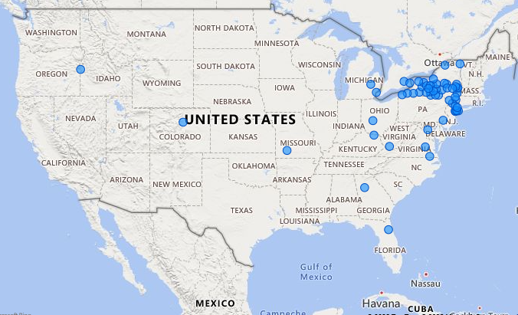
Map Insights
Map highlights solar plant locations, showing higher electricity production in areas with low usage of divisions, utilities, and metering methods.
Clearly visible: some solar plants cluster together, while larger, high-production plants are located far from main cities.

Slide 11
Applied One-Hot Encoding to nominal variables, converting categories into binary columns to avoid implying order.
Used Label Encoding for ordinal variables to preserve their natural order with numerical values.
Scaled three energy production columns to a common scale for easier model interpretation and improved performance.
feature engineering

Slide 12
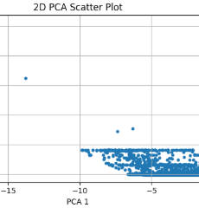
PCA Clustering Summary
The wide gap between the main cluster and isolated points highlights clear separation, pointing to at least two distinct clusters.
A few points spread across varying PCA 2 values, away from the main cluster, may represent outliers or a potential third cluster.
This clustering pattern suggests the model can identify 2-3 groups, reflecting diverse feature relationships within

Slide 13
Clustering Model Performance
Built a K-Means model and analyzed optimal clusters using the Elbow method.
Applied Hierarchical clustering (Agglomerative) with a Silhouette Score of 0.97 for 2 clusters.
Tested multiple cluster counts; the best score (0.97) achieved with 2 clusters in Hierarchical clustering.
Hierarchical model outperformed K-Means, achieving the best score of 0.97.
Score of 0.97 (close to 1) indicates excellent clustering; further tuning risks overfitting, making this model the best fit.

Slide 14
THANK YOU

